Slide 1



New
life
Welcome to
“NEW LIFE”
Present by
Zenith _Spark

Slide 2




New
life
The Team
Ashab
Asir
Safayete
Nava
FOUNDER
CO-FOUNDER

Slide 3


New
life
Table of content
Introduction
Problem
Solution
How it works
Target Market
Market size
Why “New life”
Q&A
Conclusion

Slide 4

New
life
Introduction
Transforming mental health care with innovation, accessibility, and personalized support for all.

Slide 5



New
life
Problems
Suffer from depression
Grapple with anxiety
Suicide

Slide 6




New
life
Holistic Approch
1
Therapist support, tech, evidence-based therapies
Continuous Care
2
Continuous support: video calls, unlimited in-app chat
Focused & Proven
3
12 weeks, proven outcomes, flexible schedules.
Mind-Body Connection
4
Utilizing wearables, unveil links between physical, mental health.

Slide 7



New
life
Signup
First Therapist Call
How “New Life” Program work
Weekly Therapy Sessions
Daily Activities & Resources
Biofeedback & Insights

Slide 8

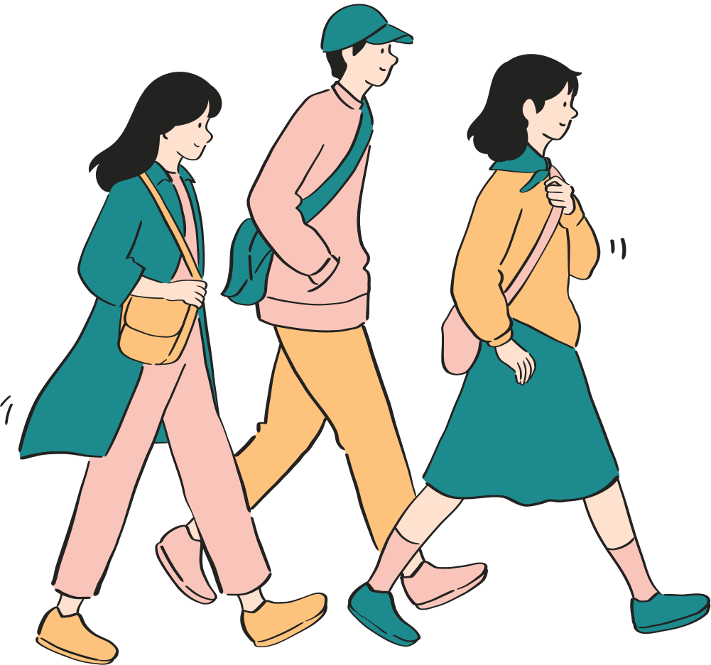


New
life
Target Market
Young Adults (18-35 years old)
Pressures from academics, career, and social complexities prevail
Women
Women in Bangladesh face mental health challenges disproportionately.
Urban Professionals
Urban life's pace fuels stress, burnout, mental health issues.

Slide 9



New
life
$165.50 million
Size
the Market
Mental health market revenue
1.52%
Bangladesh mental health market: $165.50M, CAGR 1.52% (2024).
Compound Annual Growth Rate(CAGR)

Slide 10





New
life
Revenue Model
12 Week Program
Premium Features
1:1 Therapy Sessions
Partnerships

Slide 11





New
life
Why Choose “New Life”
AI-Driven Personalized Recommendations
Downloadable Offline Resources
In-App Progress Tracker
Virtual Reality(VR) Relaxation Sessions
Companies
New
life
Features
Life spring

Slide 12
New
life
Conclusion
Present by
Zenith _Spark

Slide 13

New
life
Have Any Question
Present by
Zenith _Spark

Slide 14
New
life
Thank You
Present by
Zenith _Spark

